Slide 1
INSTITUTE OF TECHNOLOGY AND MANAGEMENT
Minor Project Report
On
Search Result
MCA 4TH SEM (Code 406)
Project Guide: Submitted by:

Slide 2
Abstract
These project is used for search an item from the particular data base of an organization like an university, college, hospital and company etc.
That means search only those item that have already exists in the database.
If the search successful than display the message “Search item is exist”.
Otherwise display the message “Search item does not exist ”.

Slide 3
Introduction
The title of these project/ software is Search Result.
The software is completely computerized based and offline work.
And handle all the activity of searching an item from the database.
The searching items may be files, folder, images, songs
etc.

Slide 4
Objective
The main objectives of the software to provide an application to the computer user which can directly access an search item from the system database.
Other objectives of these software to reduce the time consumption which are required for the manual system.

Slide 5
Numbers of Forms in s/w
Welcome Form
Login Form
Selection of Search
Images Form
Songs Form
Files Form
Direct Form

Slide 6
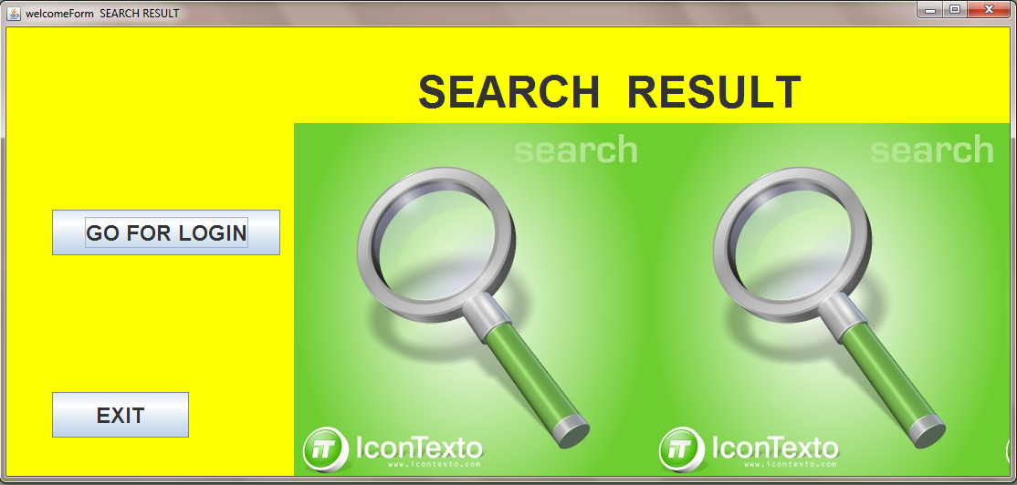

Slide 7
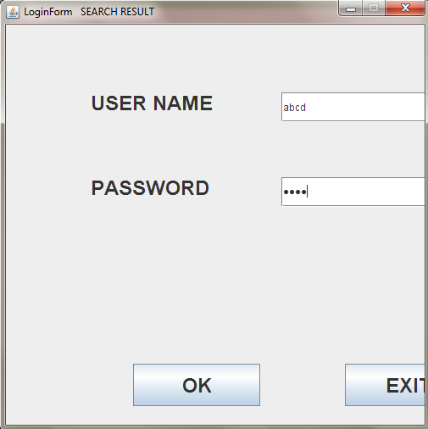

Slide 8
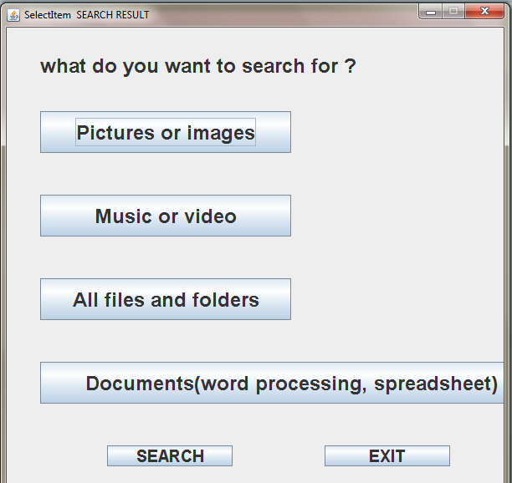

Slide 9
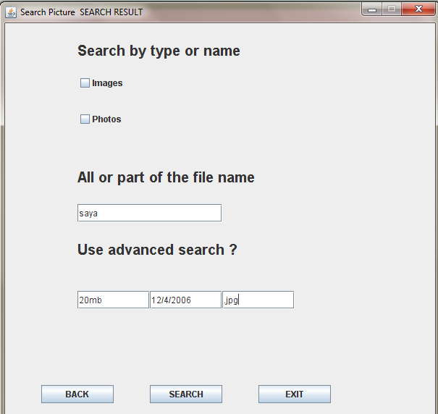

Slide 10
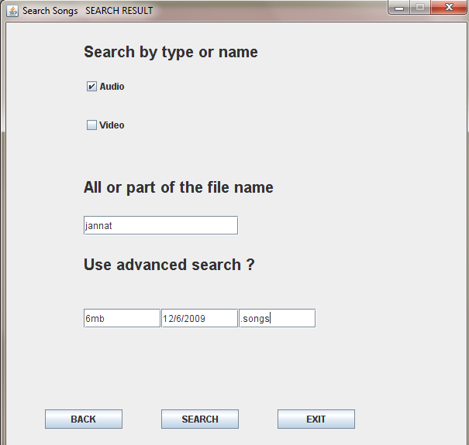

Slide 11
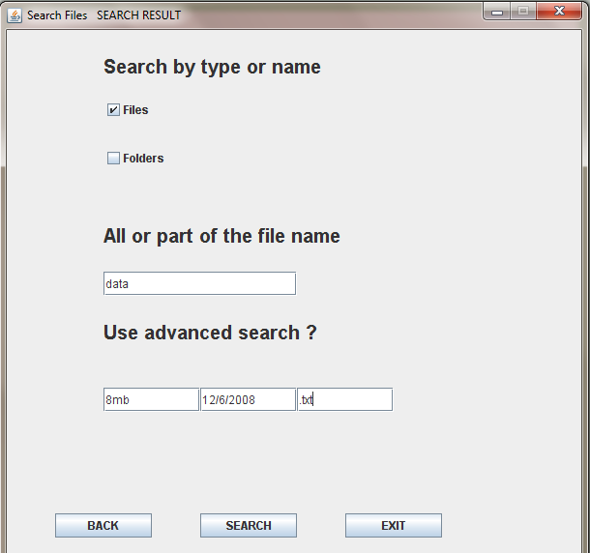

Slide 12
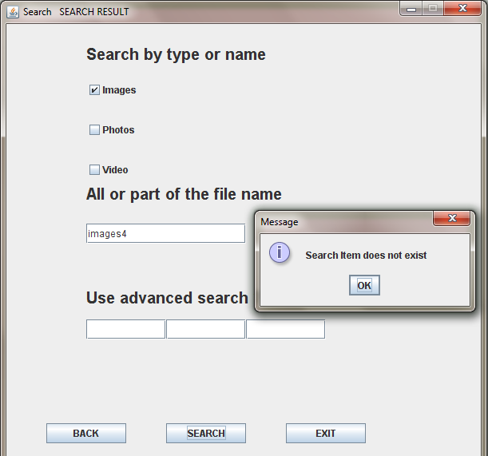

Slide 13
THANKS

